Slide 1

presentation
Profit Analysis
Project Team ID
PTID-CDA-FEB-25-374
Project Code
PRDA-01
Team
Vishnu CG
Mehfil
Lal Krishna

Slide 2
About dataset
This particular dataset holds data from 50 startups in new York, California, and Florida . The features in this dataset are R&D spending, administration spending, marketing spending , location features and profit.

Slide 3
Attribute information
R&D SPEENDING : THE AMOUNT THAT STARTUPS ARE SPENDING ON RESEARCH AND DEVELOPMENT.
ADMINISTRATION SPENDING : THE AMOUNT THAT STATUPS ARE SPENDING ON THE ADMIN PANEL.
MARKETING SPENDING : THE AMOUNT THAT STARTUPS ARE SPENDING ON MARKETING STRATEGIES.
STATE : TO WHICH STATE THAT PARTICULAR STARTUP BELONGS
PROFIT : HOW MUCH PROFIT THAT PARTICULAR STARTUP IS MAKING

Slide 4
TASK – 1
PERFORM REGRESSION ANALYSIS FOR THE GIVEN DATA TO IDENTIFY HOW THE MONEY SPENT ON MARKETING, R&D, AND ADMINISTRATION IS AFFECTING THE COMPANY’S PROFIT . PREDICT THE PROFIT FOR THE BELOW-GIVEN INPUT FEATURES
R&D SPEND ADMINISTRATION MARKETING SPEND PROFIT
21892.92 81910.77 164270.7
23940.93 96489.63 137001.1

Slide 5
REGRESSION ANALYSIS

Slide 6
What is regression ?
Regression is a statistical method used to analyze the relationship between a dependent variable (target) and one or more independent variables (predictors). It aims to find the best-fitting model that can be used to make predictions or draw conclusions about the data¹. Regression is widely used in machine learning for predictive analysis, especially when the output variable is continuous, such as predicting salary, weight, or house prices

Slide 7
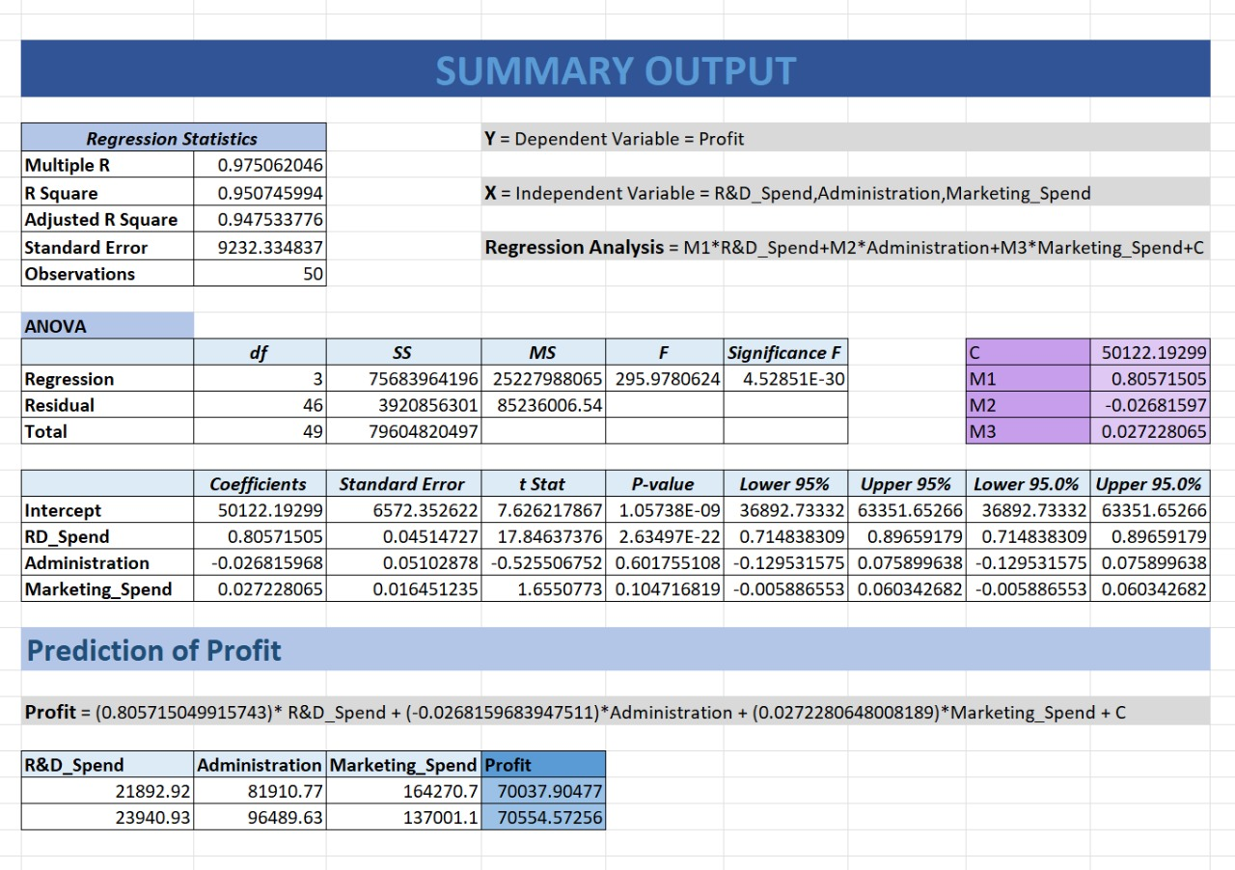

Slide 8
Data visualization

Slide 9
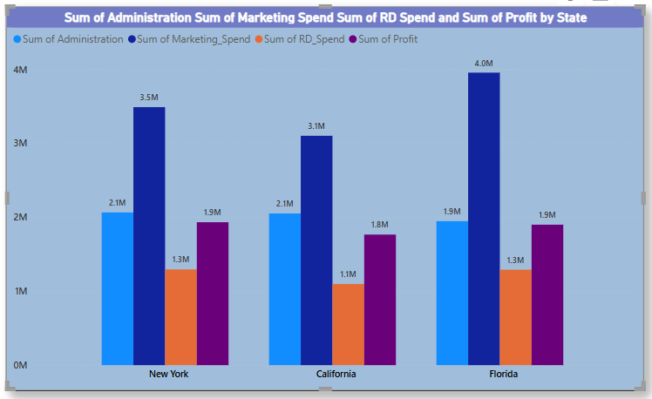
Here cluster column shows us profit of sum of all three administration , marketing spend , rd spend by state New York state administration value 2.1M , marketing spend 3.5m , rd spend 1.3m by the three of them we can find that marketing spend amount is more and new York profit is 1.3m California state administration value 2.1m , marketing spend 3.1m, rd spend 1.1m, and California profit is 1.8m here also marketing spend is more compare to others Florida state administration value 1.9m, marketing spend 4.0m, rd spend 1.1m, profit is 1.9m from three states marketing spend is high compare to others, we can say that profit depends on marketing spend new York and Florida profit is high compare to the California

Slide 10
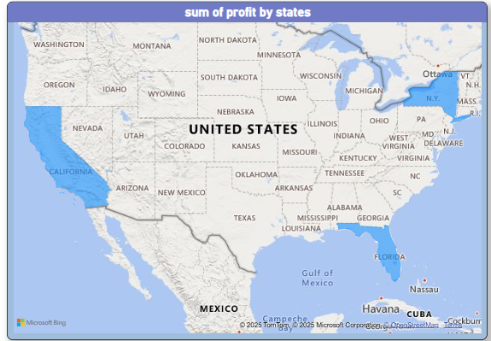
Filled map shows the graphical representation of three states we can came to know that the exact location of the states united states we can see blue colour regions are the new York , California , and Florida this visualization makes us to understand area where it is and size of the state

Slide 11
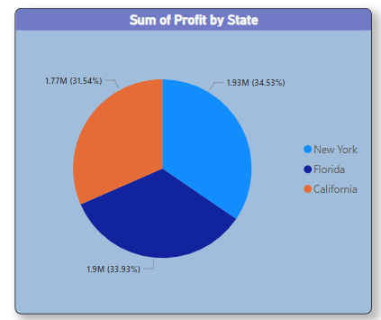
Pie chart is to show a total amount is divided into parts , or categories pie chart are useful for comparing the relative contributions of different categories to a whole here three states categories by profit is 1.77m, 1.93m and 1.9m we can understand little bit more here orang colour part is California having 31.54%, blue colour part is new York having 34.53% , and dark blue colour part is Florida having 33.93% observation : three states having almost balanced percentages new York gained more profit

Slide 12
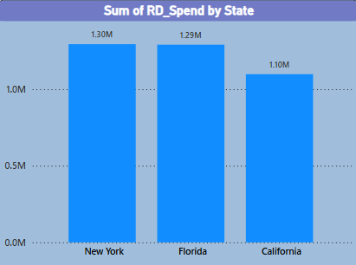
Column chart used to visually compare different categories of data by displaying their values as vertical bars , making it easy to see relative sizes and quickly identify differences between each category at a glance here column chart shows sum of rd spend by states new York , Florida and California new York spends 1.30m,florida spends 1.29m and California spends 1.10m observation: new York spends more rd compare to other two states we can also say that because of more spending rd new York got more profit rather then other two states Florida and California

Slide 13
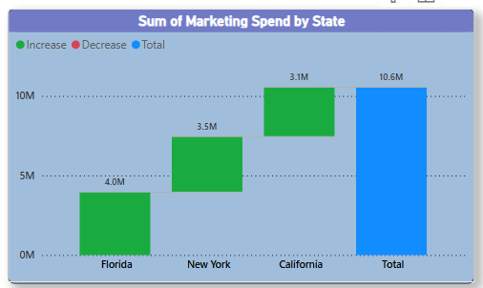
Water fall chart that visually depicts how an initial values is affected by a series of sequential positive and negative values green colour tells us increasing and blue colour is total sum of marketing spend observation: by seeing this chart we can easily say that there is no decreasing Florida marketing spend 4.0m, new York 3.5m, California 3.1m total marketing spend by three states are 10.6m

Slide 14
Power BI Dashboard

Slide 15
